Slide 1
Transform and Conquer

Slide 2
Announcements
Homework 3 assigned

Slide 3
Transform and Conquer
First: Transform problem instance to form that is more amenable to solution.
Instance Simplification: simpler instance of same problem.
Representation Change: different representation of same instance.
Problem Reduction: instance of different problem for which algorithm is already available.
Second: Solve it!

Slide 4
Presorting
Instance Simplification

Slide 5
Presorting
Many list operations easier on sorted lists
Interest in sorting algorithms largely due to value of presorting.
Efficiency of algorithms using presorting can’t be better than Θ(n log n), why?

Slide 6
Presorting
Many list operations easier on sorted lists
Interest in sorting algorithms largely due to value of presorting.
Efficiency of algorithms using presorting can’t be better than Θ(n log n), why?
Which sorting algorithm should we use?

Slide 7
Element Uniqueness
PresortElementUniqueness(A[0…n-1])
sort array A
for i ← 0 to n-2 do
if A[i] = A[i+1]
return false
return true
What is the big-Θ of this algorithm?

Slide 8
Element Uniqueness
PresortElementUniqueness(A[0…n-1])
sort array A
for i ← 0 to n-2 do
if A[i] = A[i+1]
return false
return true
What is the big-Θ of this algorithm?
T(n) = T_{sort}(n) + T_{scan}(n) Є Θ(n log n) + Θ(n) = Θ(n log n)

Slide 9
Element Uniqueness
PresortElementUniqueness(A[0…n-1])
sort array A
for i ← 0 to n-2 do
if A[i] = A[i+1]
return false
return true
What is the big-Θ of this algorithm?
T(n) = T_{sort}(n) + T_{scan}(n) Є Θ(n log n) + Θ(n) = Θ(n log n)
Brute Force: compare all pairs. Big-Θ?

Slide 10
Element Uniqueness
PresortElementUniqueness(A[0…n-1])
sort array A
for i ← 0 to n-2 do
if A[i] = A[i+1]
return false
return true
What is the big-Θ of this algorithm?
T(n) = T_{sort}(n) + T_{scan}(n) Є Θ(n log n) + Θ(n) = Θ(n log n)
Brute Force: compare all pairs.
0 + 1 + 2 + … + n-2 + n-1 = Θ(n²)

Slide 11
Searching
What is the big-Θ of searching an unsorted array?
What is the big-Θ of searching a sorted array?
What is the big-Θ of presorting then searching an unsorted array?
Is presorting a good approach to this problem?

Slide 12
Further Applications
List Processing, e.g. Mode
Geometric Problems: common to presort points by one coordinate.
Graph Problems: many are easier to solve after topologically sorting.
Greedy Algorithms (Ch. 9): generally require presorting

Slide 13
Gaussian Eliminiation
Instance Simplification

Slide 14
Back to Algebra class …
What is the solution to the following system of equations? 18x + 4y = 76 2x + 10y = 104

Slide 15
System of Equations
In many applications, need to solve system of n equations with n variables. a₁₁x₁ + a₁₂x₂ + … + a_{1n}x_{n} = b₁ a₂₁x₁ + a₂₂x₂ + … + a_{2n}x_{n} = b₂ … a_{n1}x₁ + a_{n2}x₂ + … + a_{nn}x_{n} = b_{n}
Substitution method from algebra class too cumbersome
Gaussian elimination: transform system to system with upper triangular coefficient matrix.

Slide 16
Gaussian Elimination
Gaussian elimination: transform system to system with upper triangular coefficient matrix.
Easy to solve via back substitutions
a'₁₁x₁ + a'₁₂x₂ + a'₁₃x₃ + … + a'_{1n-1}x_{n-1} + a'_{1n}x_{n} = b'₁ a'₂₂x₂ + a'₂₃x₃ + … + a'_{2n-1}x_{n-1} + a'_{2n}x_{n} = b'₂ a'₃₃x₃ + … + a'_{3n-1}x_{n-1} + a'_{3n}x_{n} = b'₃ … a'_{1n-1}x_{n-1} + a‘_{1n}x_{n} = b'_{n-1} a'_{nn}x_{n} = b'_{n}

Slide 17
Gaussian Elimination
Operations available to transform matrix A to matrix A’:
Exchange two equations in system
Replace equation with its non-zero multiple
Replace an equation with a sum or difference of this equation with another equation.

Slide 18
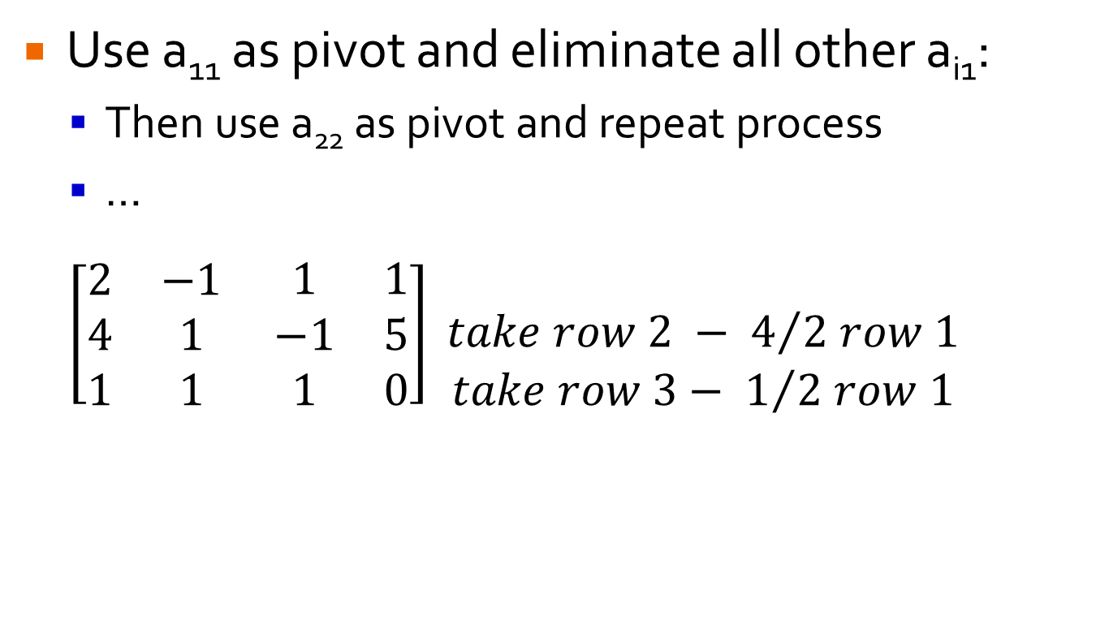
Gaussian Elimination
Use a₁₁ as pivot and eliminate all other a_{i1}:
Then use a₂₂ as pivot and repeat process
…
$$\left[\begin{matrix}2 & −1 \\ 4 & 1 \\ 1 & 1\end{matrix} \begin{matrix}1 & 1 \\ −1 & 5 \\ 1 & 0\end{matrix}\right]\begin{matrix} \\ take row 2 − 4/{2 row 1 } \\ take row 3− 1/{2 row 1}\end{matrix}$$

Slide 19
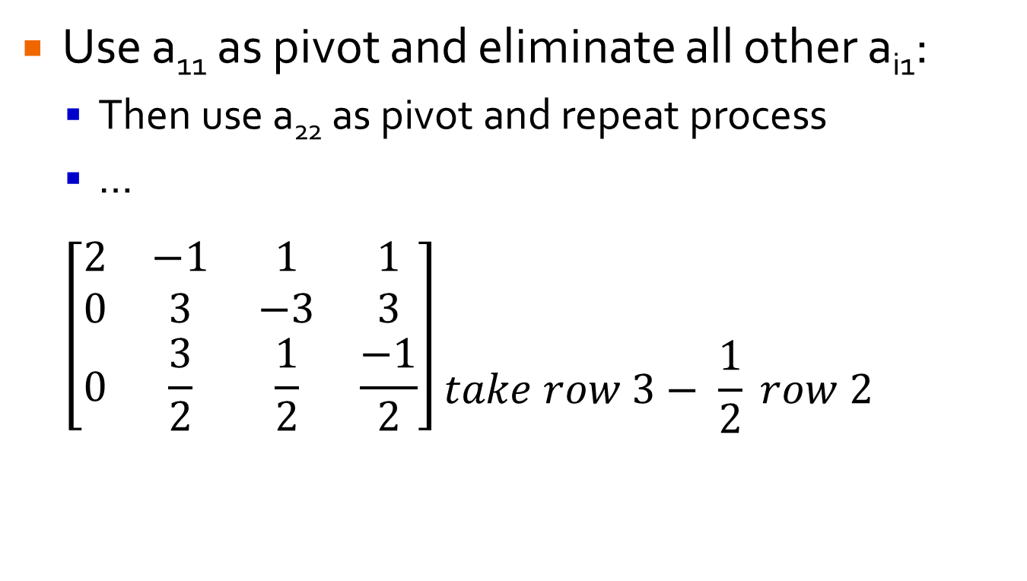
Gaussian Elimination
Use a₁₁ as pivot and eliminate all other a_{i1}:
Then use a₂₂ as pivot and repeat process
…
$$\left[\begin{matrix}2 & −1 \\ 0 & 3 \\ 0 & \frac{3}{2}\end{matrix} \begin{matrix}1 & 1 \\ −3 & 3 \\ \frac{1}{2} & \frac{−1}{2}\end{matrix}\right]\begin{matrix} \\ \\ take row 3− \frac{1}{2} row 2\end{matrix}$$

Slide 20
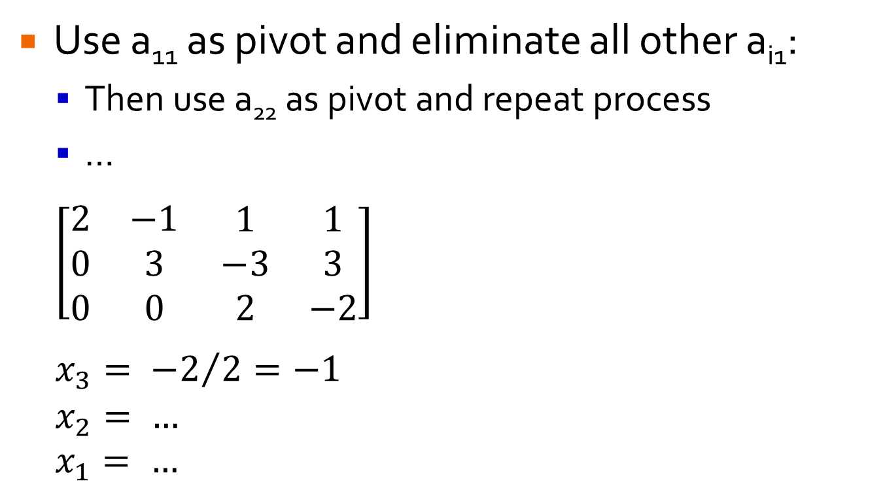
Gaussian Elimination
Use a₁₁ as pivot and eliminate all other a_{i1}:
Then use a₂₂ as pivot and repeat process
…
$$\left[\begin{matrix}2 & −1 \\ 0 & 3 \\ 0 & 0\end{matrix} \begin{matrix}1 & 1 \\ −3 & 3 \\ 2 & −2\end{matrix}\right]$$
$$x_{3}= {−2}/2=−1$$
$$x_{2}= …$$
$$x_{1}= …$$

Slide 21

Gaussian Elimination
Your Turn…
$$\text{x}\text{1}\text{ + }\text{x}\text{2}\text{ + }\text{x}\text{3}\text{ + }\text{x}\text{4}\text{ = 6} \\ \text{x}\text{1}\text{ − 2}\text{x}\text{2}\text{ − }\text{x}\text{3}\text{ + }\text{x}\text{4}\text{ = 1} \\ \text{ −}\text{x}\text{1}\text{ + 2}\text{x}\text{2}\text{ + 4}\text{x}\text{3}\text{ − 3}\text{x}\text{4}\text{ = 9} \\ \text{−2}\text{x}\text{1}\text{ + 4}\text{x}\text{2}\text{ + 5}\text{x}\text{3}\text{ + 7}\text{x}\text{4}\text{ = 19}$$

Slide 22
Transform and Conquer
First: Transform problem instance to form that is more amenable to solution.
Instance Simplification: simpler instance of same problem.
Representation Change: different representation of same instance.
Problem Reduction: instance of different problem for which algorithm is already available.
Second: Solve it!

Slide 23
Heaps
Representation Change

Slide 24
Heap
Partially Sorted Data Structure
Ideal for Priority Queues
Good for process scheduling, network traffic management, various algorithms (Prim’s, Dijkstra’s, Huffman, A*, etc.)
Cornerstone of heapsort

Slide 25
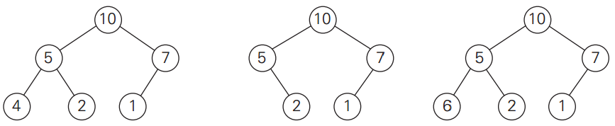
Heap
Heap: a binary tree that has 2 properties:
Shape property: tree is complete – all levels are full except for last, which is filled from left to right.
Heap property: the key in each node is greater* than or equal to key in each of its children.
Order of children irrelevant

Slide 26
Heap Properties
Only one complete tree with n nodes. Height is always log₂n.
Root always largest* key value.
Each subpart of tree is a heap.
9
8
7
5
2
1
6
3
5
1

Slide 27
Array Representation
 | 9 | 8 | 7 | 5 | 2 | 1 | 6 | 3 | 5 | 1
0 | 1 | 2 | 3 | 4 | 5 | 6 | 7 | 8 | 9 | 10
Most languages provide function to heapify an array/list.
heapq in Python
9
8
7
5
2
1
6
3
5
1

Slide 28
Array Representation
 | 9 | 8 | 7 | 5 | 2 | 1 | 6 | 3 | 5 | 1
0 | 1 | 2 | 3 | 4 | 5 | 6 | 7 | 8 | 9 | 10
Where is parent of node i?
9
8
7
5
2
1
6
3
5
1

Slide 29

Array Representation
 | 9 | 8 | 7 | 5 | 2 | 1 | 6 | 3 | 5 | 1
0 | 1 | 2 | 3 | 4 | 5 | 6 | 7 | 8 | 9 | 10
Where is parent of node i? $\left\lfloor i/2\right\rfloor$
9
8
7
5
2
1
6
3
5
1

Slide 30
Array Representation
 | 9 | 8 | 7 | 5 | 2 | 1 | 6 | 3 | 5 | 1
0 | 1 | 2 | 3 | 4 | 5 | 6 | 7 | 8 | 9 | 10
Where is left child of node i?
9
8
7
5
2
1
6
3
5
1

Slide 31
Array Representation
 | 9 | 8 | 7 | 5 | 2 | 1 | 6 | 3 | 5 | 1
0 | 1 | 2 | 3 | 4 | 5 | 6 | 7 | 8 | 9 | 10
Where is left child of node i? 2i
9
8
7
5
2
1
6
3
5
1

Slide 32
Array Representation
 | 9 | 8 | 7 | 5 | 2 | 1 | 6 | 3 | 5 | 1
0 | 1 | 2 | 3 | 4 | 5 | 6 | 7 | 8 | 9 | 10
Where is right child of node i?
9
8
7
5
2
1
6
3
5
1

Slide 33
Array Representation
 | 9 | 8 | 7 | 5 | 2 | 1 | 6 | 3 | 5 | 1
0 | 1 | 2 | 3 | 4 | 5 | 6 | 7 | 8 | 9 | 10
Where is right child of node i? 2i + 1
9
8
7
5
2
1
6
3
5
1

Slide 34
Constructing a Heap: Θ(n)
HeapBottomUp(H[1…n])
for i ← floor(n/2) downto 1 do
k ← i
v ← H[k]
heap ← false
while not heap and 2*k ≤ n do
j ← 2 * k
if j < n // there are 2 children
if H[j] < H[j+1]
j ← j + 1
if v ≥ H[j]
heap ← true
else
H[k] ← H[j]
j ← k
H[k] ← v
Convert to array representation and run HeapBottomUp
2
9
7
6
5
8

Slide 35
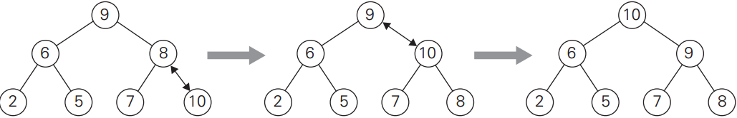
Heap Push: Θ(log₂n)
HeapPush(H[1…n], k)
H[n+1] ← k
i ← n+1
heap ← false
while not heap and i ≠ 1 do
p ← floor(i/2)
if H[i] > H[p]
swap H[i] and H[p]
i ← p
else
heap ← true

Slide 36
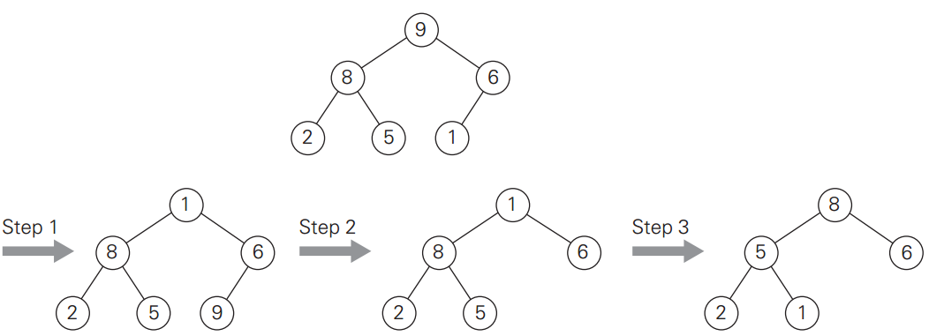
Heap Pop: Θ(log₂n)
Pops root – largest item
Often returns item in addition to removing

Slide 37
Your Turn …
Imagine that you start with an empty max-heap. Draw the heap (in tree format) after each of the following operations. heap_push(10) heap_push(5) heap_push(11) heap_push(6) heap_push(2) heap_pop()

Slide 38
Heapsort
Construct heap from array
Call heap pop repeatedly until empty (could add popped items into new array if desired)
What would Big-Θ of Heapsort be?

Slide 39
Heapsort
Construct heap from array
Call heap pop repeatedly until empty (could add popped items into new array if desired)
What would Big-Θ of Heapsort be? T(n) = T(construct) + n * T(pop) = Θ(n) + n * Θ(log₂n) = Θ(n log₂n)
Comparable to mergesort

Slide 40
Balanced Search Trees

Slide 41
BST
Converting list to BST is a transformation change, what do we gain?
Best/Avg. Case?
Worst Case?

Slide 42
BST
9
Converting list to BST is a transformation change, what do we gain?
Best/Avg. Case: Θ(log n) insert, search, etc.
Worst Case: nothing, still Θ(n)
8
6
6
5
6
2
8
2
1
5
6
9
1

Slide 43
How to Avoid BST Worst Case?
Instance Simplification: if an insertion breaks balance rule, use rotation to restructure tree.
AVL Tree
Others: Red-Black Tree, Splay Tree
Representation Change: allow more than one item in each node:
2-3 Trees
Others: B-Trees

Slide 44
AVL Trees
AVL Tree: a BST in which the balance factor of every node is either 0, +1 or -1.
Balance Factor: the difference between heights of the nodes left and right subtrees. What is balance factor of nodes in this BST? Is it an AVL tree?
7
3
9
2
5
1
6
Notes:
Named for Adelson-Velsky and Landis.

Slide 45
AVL Trees
AVL Tree: a BST in which the balance factor of every node is either 0, +1 or -1.
Balance Factor: the difference between heights of the nodes left and right subtrees. Is it an AVL tree? No.
7
2
3
0
9
0
1
2
5
-1
0
1
6
0
Notes:
Named for Adelson-Velsky and Landis.

Slide 46
AVL Trees
AVL Tree: a BST in which the balance factor of every node is either 0, +1 or -1.
Balance Factor: the difference between heights of the nodes left and right subtrees. This IS an AVL tree.
7
1
3
0
9
1
1
2
5
-1
0
8
0
1
6
0
Notes:
Named for Adelson-Velsky and Landis.

Slide 47
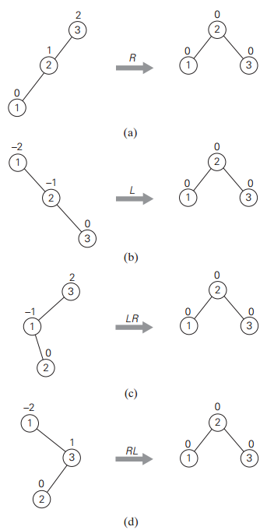
Rotations
If insertion leads a node to have +2 or -2, perform one of 4 possible rotations to rebalance.
If more than one such node, rotate one closest to inserted leaf.

Slide 48
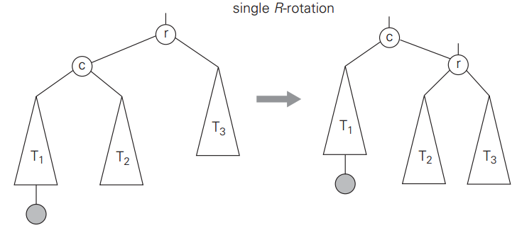
R-rotation
Performed after new key inserted into left subtree of left child causing +2 balance factor.
r: node with +2 balance factor c: left child of r
L-rotation is mirror image (-2 balance factor)
Is BST order preserved?

Slide 49
R-rotation
Create pointers to r, c and parent of r
Move r’s lchild pointer from c to T2
Move c’s rchild pointer from T2 to r
Move parent of r’s child pointer from r to c.
Θ?

Slide 50
R-rotation
Create pointers to r, c and parent of r
Move r’s lchild pointer from c to T2
Move c’s rchild pointer from T2 to r
Move parent of r’s child pointer from r to c.
Θ(1)

Slide 51
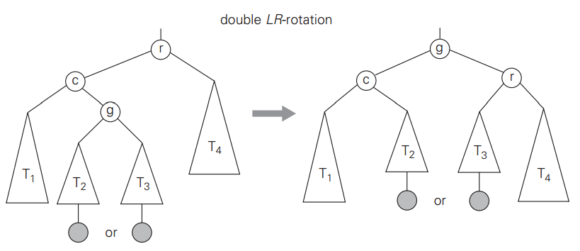
LR-rotation
An L-rotation followed by an R-rotation. Performed after key inserted into right subtree of left child causing +2 balance factor.
RL-rotation is mirror image.

Slide 52
AVL Trees
Leads to search, insert, remove all being Θ(log₂n) in best, worst and average case.
Not widely used, due to frequent rotations.
Generated idea of rebalancing, which is used in other tree implementations.

